Slide 1


A Micro Project Presentation
HR ANALYTICS DASHBOARD USING TABLEAU
Submitted by
BOPPANA ROHITH (99220041454)
B.Tech – Computer Science and Engineering, AIML

Slide 2
Project Guide
Evaluator
Faculty Incharge
Dr. J. Jane Rubel Angelina
Associate professor
Computer Science and Engineering
Kalasalingam Academy of Research and Education
Krishnan kovil - 626126
Mr. M. K. Nagarajan
Assistant professor
Computer Science and Engineering
Kalasalingam Academy of Research and Education
Krishnan kovil - 626126
Dr. P. Anitha
Assistant professor
Computer Science and Engineering
Kalasalingam Academy of Research and Education
Krishnan kovil - 626126

Slide 3
Abstract
In the realm of human resources management, effective decision-making relies heavily on insightful analytics. This project introduces an HR Analytics Dashboard leveraging Tableau, offering a comprehensive overview of vital workforce metrics. The dashboard encapsulates key indicators including employee count, attrition statistics, and attrition rates, providing real-time insights into workforce dynamics. Additionally, it furnishes detailed breakdowns such as department-wise attrition, distribution of employees across age groups, job satisfaction ratings, and attrition patterns across gender and education fields. By amalgamating data visualization with advanced analytics, this dashboard empowers HR professionals to make data-driven decisions, optimize retention strategies, and enhance organizational performance.
Notes:
(These don’t have designer IDs since they were based off the default master slides already in the deck.

Slide 4
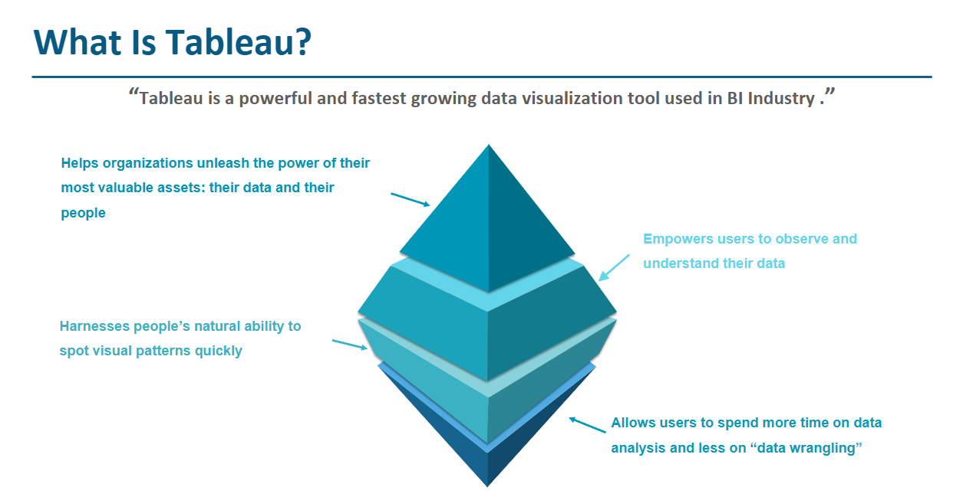

Slide 5
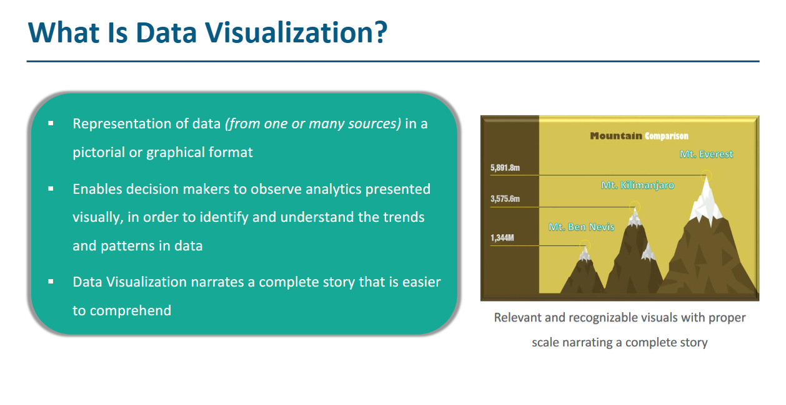

Slide 6
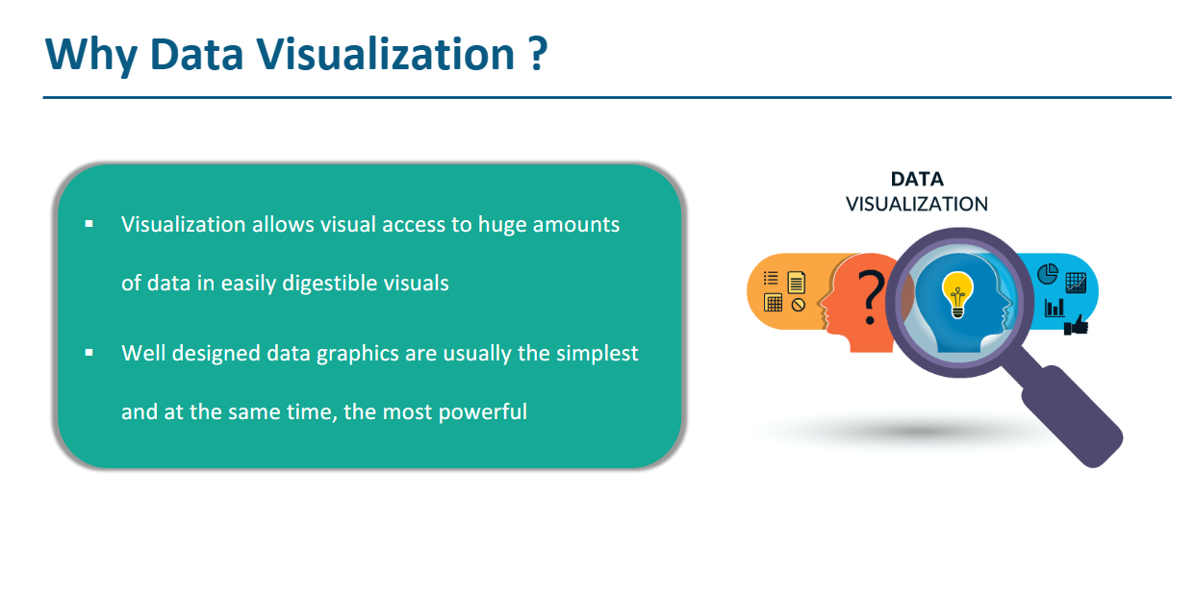

Slide 7
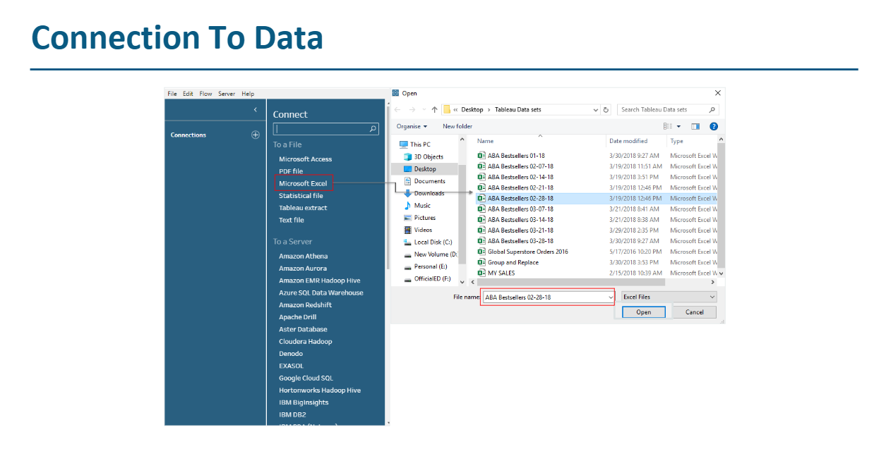

Slide 8
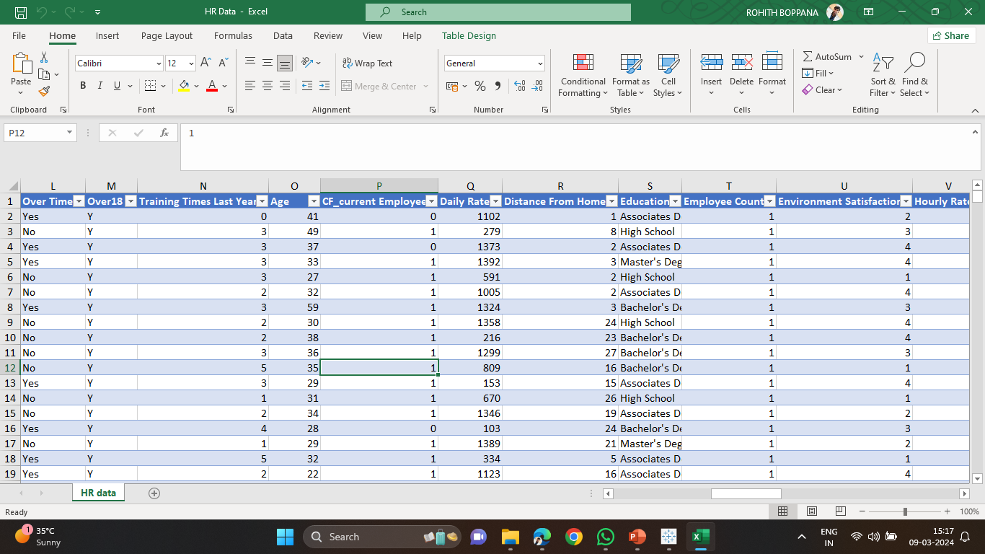

Slide 9
1. Employee Count:
Visual: Utilize a pie chart or bar graph to represent the distribution of employees across departments, job roles, or locations.
Description: This visualization provides a breakdown of the workforce composition, aiding in resource allocation and workforce planning.
2. Attrition Rate:
Visual: Display the attrition rate trend over time using a line chart.
Description: This chart showcases the trend in attrition rates, helping to identify patterns and potential areas for improvement in employee retention strategies.

Slide 10
3. Attrition Count:
Visual: Show the total number of employees who left the organization within a specified period using a bar chart.
Description: This visualization offers a snapshot of the attrition count, allowing for a quick assessment of the magnitude of employee turnover.
4. Active Employees:
Visual: Represent the percentage of active employees compared to the total workforce using a pie chart or KPI.
Description: This metric highlights the proportion of engaged employees within the organization, aiding in monitoring employee satisfaction and retention efforts.

Slide 11
5. Average Age:
Visual: Utilize a histogram or bar chart to showcase the distribution of employees' ages.
Description: This visualization provides insights into the age diversity within the workforce, informing talent management strategies and succession planning.
6. Attrition by Gender:
Visual: Display attrition rates for male and female employees using a stacked bar chart or side-by-side bar chart.
Description: This chart identifies any gender disparities in attrition rates, enabling targeted interventions to address retention challenges.

Slide 12
7. Department-wise Attrition:
Visual: Present attrition rates for different departments using a grouped bar chart or heatmap.
Description: This visualization helps identify departments with higher attrition rates, guiding efforts to implement tailored retention strategies.
8. Employees by Age Group:
Visual: Showcase the distribution of employees across different age groups using a pie chart or bar chart.
Description: This chart offers insights into the age demographics of the workforce, informing initiatives related to training, development, and workforce planning.

Slide 13
9. Job Satisfaction Rating:
Visual: Utilize a horizontal bar chart or radar chart to depict employees' job satisfaction ratings.
Description: This visualization captures employees' perceptions of job satisfaction, aiding in the identification of areas for improvement in organizational culture and employee engagement.
10. Education Field-wise Attrition:
Visual: Show attrition rates by education field using a stacked bar chart or treemap. - Description: This visualization highlights attrition patterns across different educational backgrounds, informing recruitment strategies and career development initiatives.

Slide 14
11. Attrition Rate by Gender for Different Age Groups:
Visual: Use multiple line charts or a combination chart to compare attrition rates by gender for different age groups. - Description: This chart examines how attrition rates vary by gender across various age demographics, offering insights into potential factors influencing employee turnover at the intersection of gender and age.

Slide 15
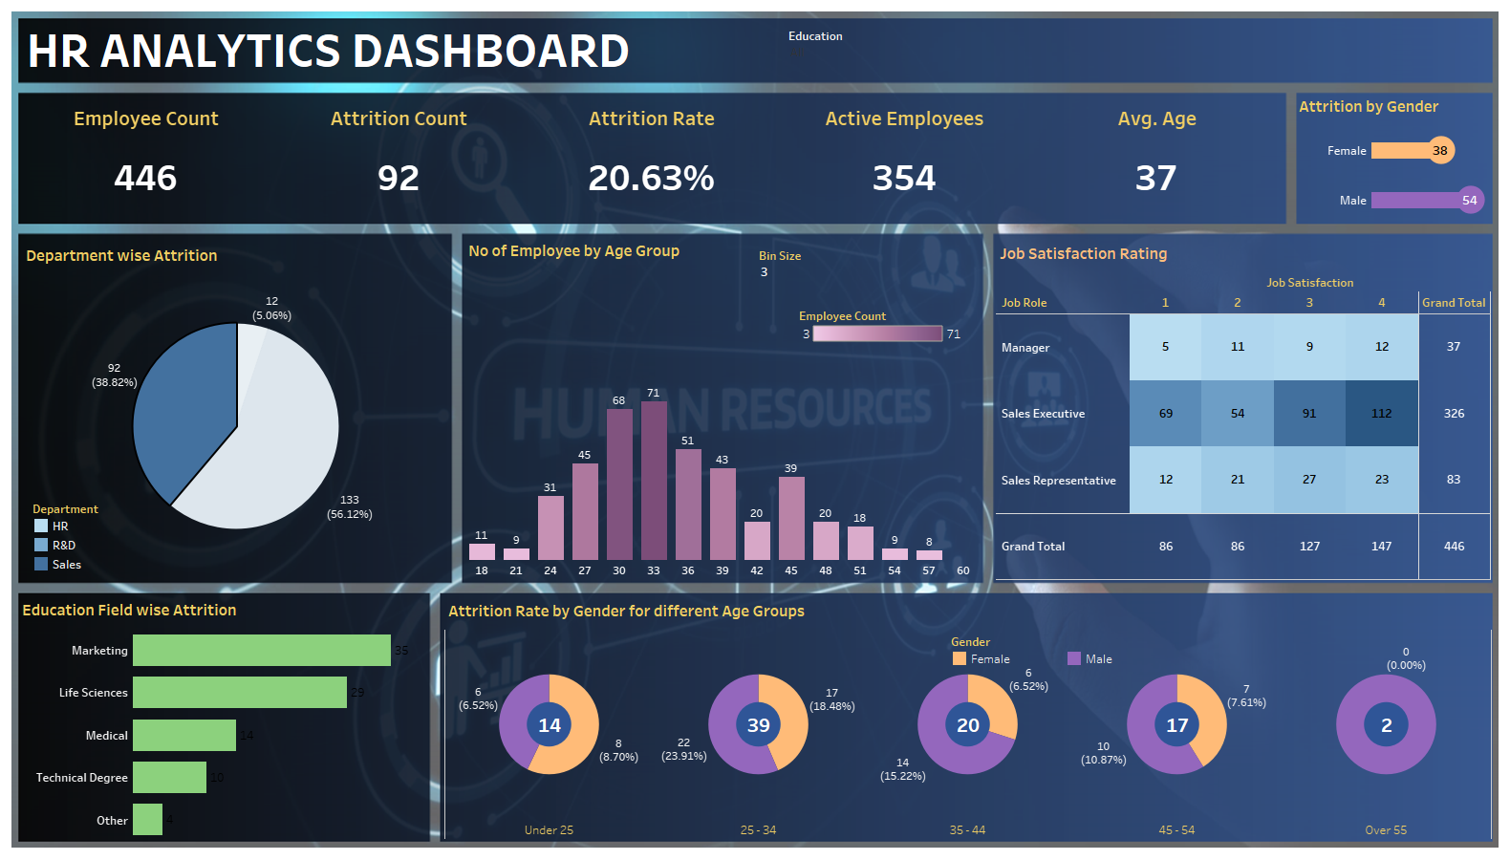

Slide 16
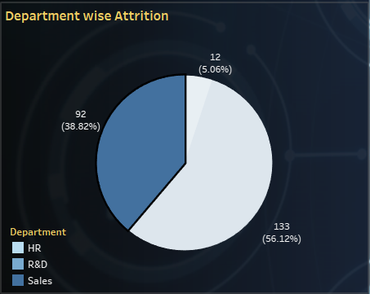

Slide 17
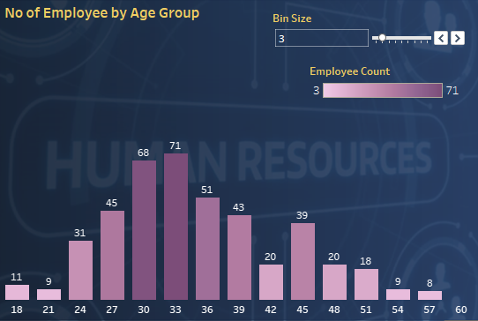

Slide 18
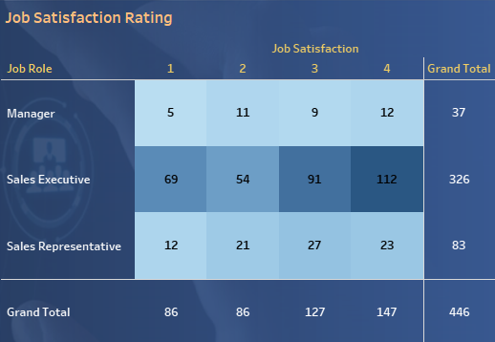

Slide 19
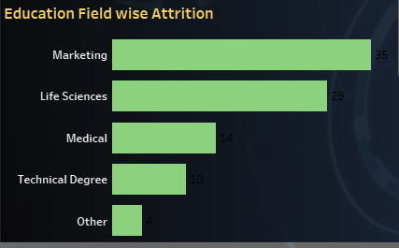

Slide 20
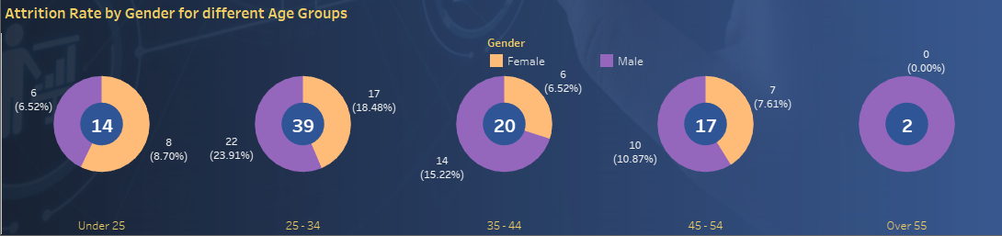

Slide 21
Conclusion
The HR Analytics dashboard serves as a powerful tool for modern businesses to enhance their human resources management strategies. By providing comprehensive insights into employee performance, engagement, retention, and other key metrics, it enables HR professionals to make data-driven decisions that optimize workforce productivity and organizational success.

Slide 22

Thank You

